Slide 1
BLOCKCHAIN
PreHISTORY & OVERVIEW
Pr. TMIMI Mehdi

Slide 2


Main goal
Discuss the different technologies and developments that led up to the first modern cryptocurrency : BITCOIN
Notes:
Blockchain has multiple uses cases: Currency, logistics, NFTs …
We will focus on currency because it was the first use case for blockchain

Slide 3
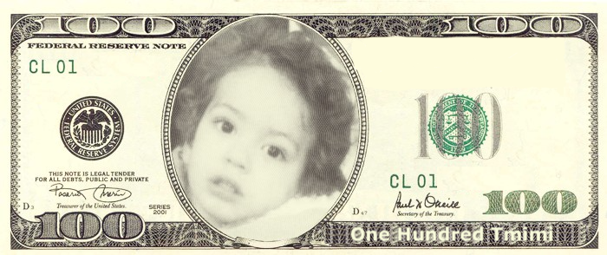
From the beginning
Let' say you want to create your own currency named (Tmimi)

Slide 4

From the beginning
What Characteristics should it have?

Slide 5
Properties of money
Durability
Portability
Divisibility
Uniformity
Limited Supply
Acceptability
Notes:
Durability: not easy to destroy, it has some resistance
Portability: it can be moved easily from one place to another => not really useful if it's hard to move or unmovable
Divisibility: it's divisible into small values, change (serf)
Uniformity: 1 bill Tmimi should be equal to another 1 bill Tmimi, no difference at all !
Limited Supply: it should be something with limited supply, not infinite or practically infinite (sand from the beach)
Acceptability: general acceptability from people to use it as currency

Slide 6

Credit vs cash
Monetary systems:
Credit: Debt-based system
Cash: medium of exchange
=> Both systems are not perfect

Slide 7
Reality
Different societies used different mechanisms
For debt system: it's relatively easy to track who owns whom in both real world and digital world.
For cash: we find a variety of physical objects ( silver, gold, etc. )
=> The main problem: it' hard to translate it (cash) into the digital world.
Why ?

Slide 8
Credit :digital form attempts
First Virtual
Basically, you would give them your credit card information, they would purchase things "for" you from different sites.
=> Never caught on : merchants had to wait 90 days for every transaction to be cleared!

Slide 9
Credit :digital form attempts
SET Architecture
Allowed you to encrypt your credit card number and send an encrypted version through an intermediary.
Seller cannot see your actual credit card information – buyer, seller, and intermediary would come to an agreement by each coming up with an encrypted version.
Did not succeed because every user needed to get a certificate => back then in the '90s, getting a certificate was a hard technical process.
Notes:
SET: Secure Electronic Transaction
https://fr.wikipedia.org/wiki/Secure_Electronic_Transaction

Slide 10
Digital Credit vs Digital Cash
Credit system:
Not anonymous, very trackable
You always need to check with some authority
You are not in full control
Cash system:
Needs to be bootstrapped
No risk of default
Anonymous
Notes:
Bootstrapped: we need some way for people to agree that silver, gold is worth something.

Slide 11
Proposals for Digital Money
Chaumian Ecash:
First serious digital money proposal.
By the famous Cryptographer David Chaum in 1983.
Introducing the idea of Blind signature.
=> it was anonymous but still require centralization
=> It was commercialized as DigiCash - tried out on a single bank, but later the company went bankrupt
Notes:
A blind signature allowed someone to sign a document and prove their ownership while at the same time hiding the information in the document.
You could prove that you owned some money (stored at a bank) by signing a transaction (credit-based)
==> here we see the first early starts at using cryptography to secure our money although it was still linked in with the traditional banking system

Slide 12
The Double-Spend Issue
Mehdi has an ecash note, serial 0xA34D34DS423B67
Mehdi buys a cake from a vendor 'Ali' and he pays using the ecash note. Ali does not have access to the internet from his store.
Mehdi then goes over to Sarah's ice cream shop and pays with the same ecash note.
=> How can we prevent a 'double spend' ? Meaning: how can Sarah know that the ecash note has already been given to Ali.
Notes:
The reason why it has to be linked to this traditional banking system (having some central authority to check with) is due to what we call the double-spend issue

Slide 13
The Double-Spend Issue
Difficult to do without a centralized source of truth
Chaumian ecash avoids the double-spend by determining AFTER the fact (Chaumian-Fiat-Nour Scheme)
You identity is safe UNLESS multiple parties try to redeem your note, in which case you are fingered as the culprit... but is done after you have already eaten your cake and ice cream.
Notes:
Culprit = criminal
After the fact = all the merchants would get together and make sure that there was no double spend

Slide 14
Anonymity
Buyers were anonymous, merchants were not.
They had to check with the centralized bank server to determine and redeem the ecash note

Slide 15

Money for "Nothing"
Chaumian ecash, despite its name, was pseudo-debt.
To get the ecash note, you need to buy it from the bank => it represented a claim on the bank's assets.
Similair proposals of chaumian ecash: Liberty Reserve, DigiGold, e-gold ...

Slide 16

Scarcity
How can we get something that was not a claim on some other asset but had value on itself ?
Notes:
Scarcity: rareté

Slide 17

Scarcity
Limited supply : Work to get it or generate it
In the digital world: you can't find physical object that are rare: easy to copy
Computers can do computation work.
=> so what about using computation work as the backing system for our currency!

Slide 18
Computational Banking
This is was the idea behind Dwork and Naor's paper(1992)
Later expanded into a commercial product with Adam Back: HashCash
=> "Bitcoin is HashCash extended with inflation control" - Adam Back
Notes:
example of sending an email but before you need to solve a puzzle, meaning there is a work that needs to be done.
=> avoid spam
=> sending emails gets expensive (to fast send emails you need to have fast computer and electricity etc.)
=> pay others to solve the puzzle for you

Slide 19
Ledgers
How to determine the order/timestamp of document in a decentralized manner ?
=> chain of documents
Notes:
Meanwhile, another problem was trying to be solved in the 80s and 90s on the concept of ledgers.
If we know Document d1 was written before d2, and d2 before d3, etc. We can have a good idea of when a document was written (order also)
How to do that ? Each document is linked to his previous

Slide 20
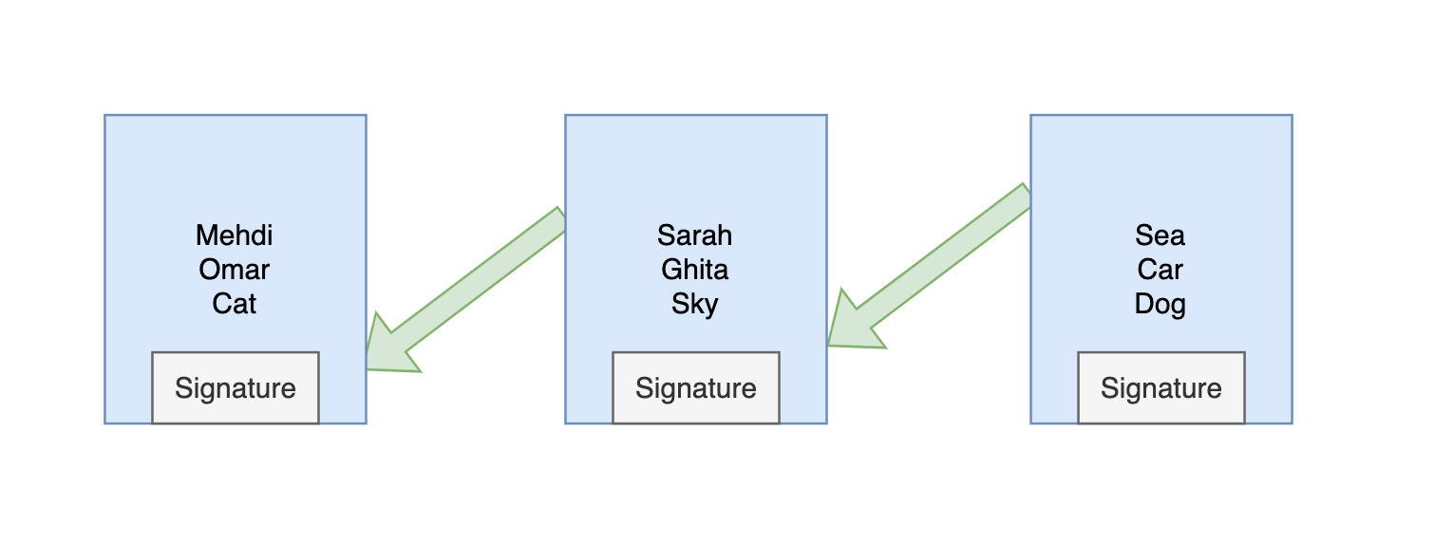
Linked Timestamping
Notes:
It turns out using cryptography we can
=> we can provide a signature that shows what the last document was

Slide 21
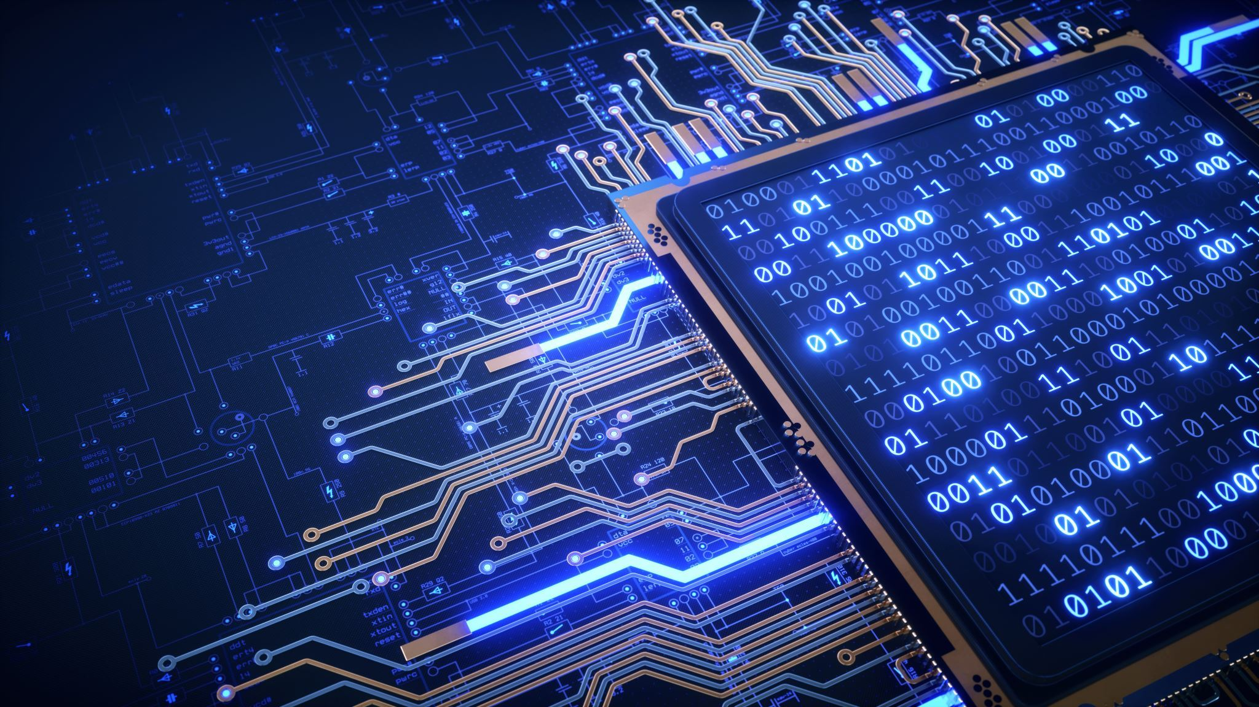
Efficiency
That much granularity (chain of document) is not efficient.
collect document into groups (Blocs) and only have the signature link going from block to block
=> in other words, we get chain of blocks (Block Chain)

Slide 22
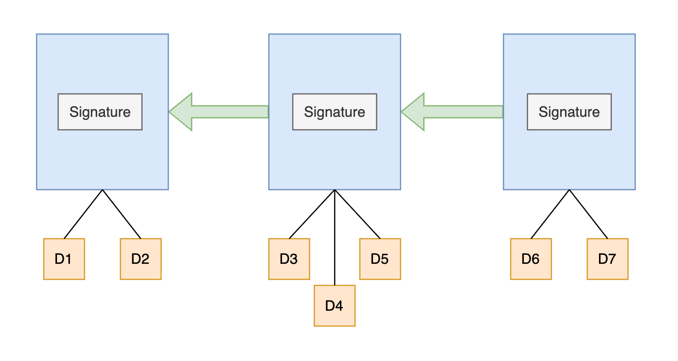
A "Block Chain"

Slide 23
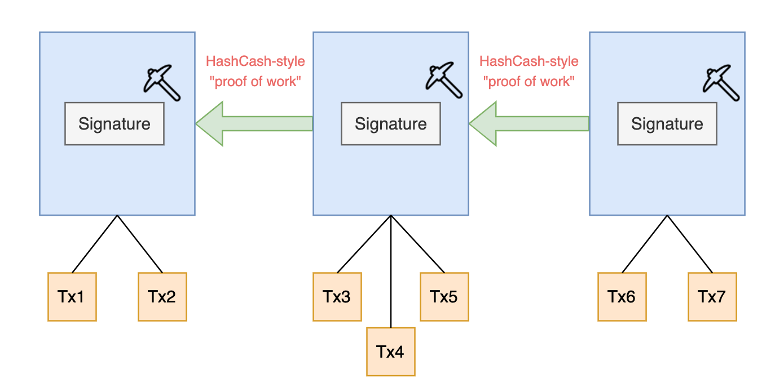
Bitcoin-style of "Block chain"
Notes:
If we then make sure that these links are very difficult computationally to make => proof of work, and change document with transaction => bitcoin style of blockchain

Slide 24
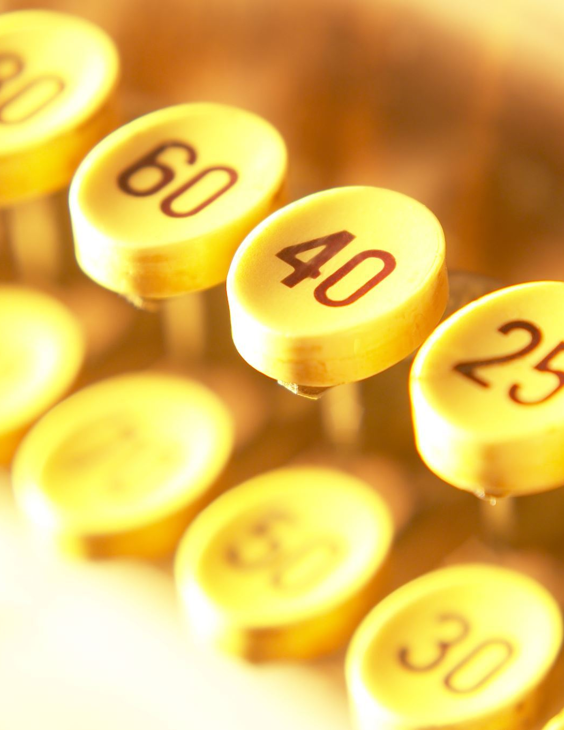
Centralization to Decentralization
If we assume that this Computationally difficult blockchain (proof of work) is the ground truth => no need for centralized server or source of truth.
=> Several proposals using this scheme: b-money(Wei Dai), bit-gold(Nick Szabo)
Problem: both these proposals used this scheme to create money but they didn’t propose how to determine what happens if users disagree on blocks
Notes:
If somehow we can get everybody to agree on the rules, and the first person to be able to generate one of these links is going to be considered the winner and also the creator of truth then we don't need any sort of arbiter.

Slide 25
Bitcoin
The first modern cryptocurrency
Decentralized – no central arbiter and no easy way to censor transactions
Transactions are signed cryptographically
Blocks added to a Blockchain with proof of work, and those who are first to create those links are rewarded with bitcoin. => race => mining
Notes:
=> Bitcoin did not appear just like that from nowhere => there were a lot of different ideas floating around and several attempts that Bitcoin put together in a way that worked !
-bitcoin is the oldest and most valuable coin
-decentralized: there is no CEO of bitcoin, no one control it => more power to users => no one to help if u send accidentally your money to the wrong address or you lost your password

Slide 26

Satoshi Nakomoto
Creator(s) of Bitcoin
It's a male Japanese name, but we don’t if it's a person (male or female) or group of persons
Notes:
Satoshi Nakamoto began coding the first implementation of Bitcoin in C++ in May of 2007. In August of 2008, he sent private emails to two well-respected cypherpunks, Hal Finney and Wei Dai, asking them for feedback on early versions of the Bitcoin white paper. They both gave Satoshi positive feedback, telling him they found it very promising.

Slide 27
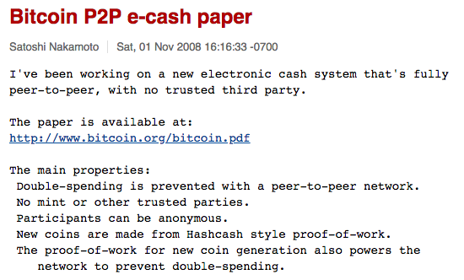
Notes:
A couple months later, Satoshi published the Bitcoin white paper to a public cryptography mailing list.

Slide 28
Resolving the Double-Spend Issue
Money For Nothing: Creation of links between blocks via complex computational challenge => creates money
In case of conflict, we consider the longest chain is valid => chain with the most work behind it
=> adding the concept of mining and get rewarded for it was really the key modification that allowed bitcoin to solve all the previous problems.
Notes:
The only way for someone to try to censor transactions (basically saying that his chain is the valid one) is to spend a lot of money to say that there is a new chain of blocks, but since you are competing with everybody else in the world ...

